Slide 1
Machine learning
Regent College London
SWE6204

Slide 2
Machine learning
SWE6204

Slide 3

Machine learning
MULTIVARIATE REGRESSION

Slide 4
Module 1 – Multi variate regression

Slide 5
Learning objectives
Understand Multivariate Regression

Slide 6
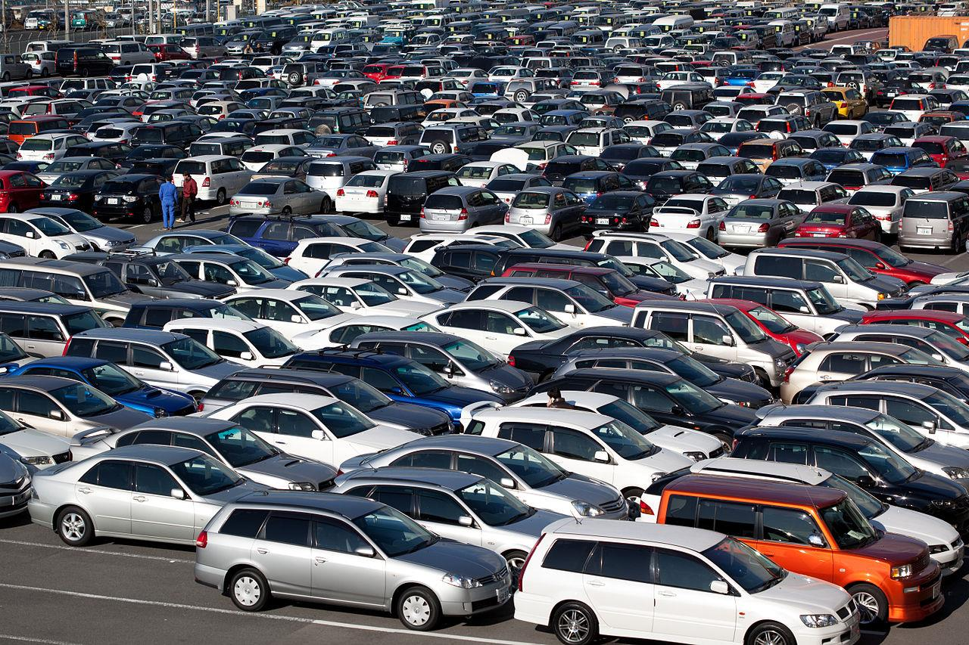
Multivariate regression
What if more than one variable influences the one, you’re interested in?
Example: predicting a price for a car based on its many attributes (body style, brand, mileage, etc.)

Slide 7
Still uses least square
We just end up with coefficients for each factor.
For example, 𝑝𝑟𝑖𝑐𝑒 = 𝛼 + 𝛽1 mileage + 𝛽2age + 𝛽3doors 123
These coefficients imply how important each factor is (if the data is all normalized!)
Get rid of ones that don’t matter!
Can still measure fit with r-squared
Need to assume the different factors are not themselves dependent on each other.

Slide 8
Python coding
Let’s dive into an example.
• The statsmodel package makes it easy.

Slide 9
quiz
Watch the you tube video on Multivariate regression (Multiple regression)
https://www.youtube.com/watch?v=zITIFTsivN8 (6 minutes)
Question – Why we use Multivariate regression to Linear Regression?

Slide 10
+44 (0)207 016 8000
info@rcl.ac.uk

